Slide 1




Identifying Ancient Glacial Features in The Circum-Argyre Region, Mars, Using HiRISE, CTX, and MOC Imagery
Alexander Prescott
Mentor: Victor R. Baker
Department of Environmental Hydrology and Water Resources
April 12, 2014
Arizona Space Grant Consortium Statewide Symposium, Tucson, AZ

Slide 2

Presentation Outline
Guiding Question
Abbreviations
History
Methods
Images
Conclusions and Further Work

Slide 3
Question
What geomorphic evidence for wet-based glacial modification of the Southern Argyre crater rim can be identified using new high-resolution imagery from the CTX, HiRISE, and MOC missions?
Some abbreviations:
CTX: Context Camera on the Mars Reconnaissance Orbiter, developed and operated by Malin Space Science Systems
HiRISE: High Resolution Imaging Science Experiment on the Mars Reconnaissance Orbiter, developed and operated by the Lunar Planetary Laboratory at the UA
MOC: Mars Orbital Camera on NASA’s Mars Global Surveyor spacecraft developed and operated by Malin Space Science Systems
JMARS: Java Mission-planning and Analysis for Remote Sensing – GIS from ASU’s Mars Space Flight Facility
HiView: Application developed by the Lunar Planetary Laboratory at the UA for viewing and analyzing HiRISE imagery

Slide 4
Research History
Several authors over the past 25 years (e.g. Banks et al. 2008, 2009; Kargel and Strom 1992; Heisinger and Head 2002; among others) have posited a history of glacial modification in and around Argyre crater
Evidence includes:
Large U-shaped valleys
Peaks sculpted into arêtes, cirques and horns
Eskers (positive relief deposits from subglacial streams)
Moraines
Streamlined features on hillslopes

Slide 5
Research Methods
Over 300 images from CTX, HiRISE, and MOC missions were interpreted, especially (but not exclusively) those images taken since 2007
JMARS (Arizona State University) was used to locate and view images
HiVIEW (Lunar Planetary Lab, UA) was used to further analyze HiRISE images
The images presented here contain features representative of what exists across this regional landscape

Slide 6
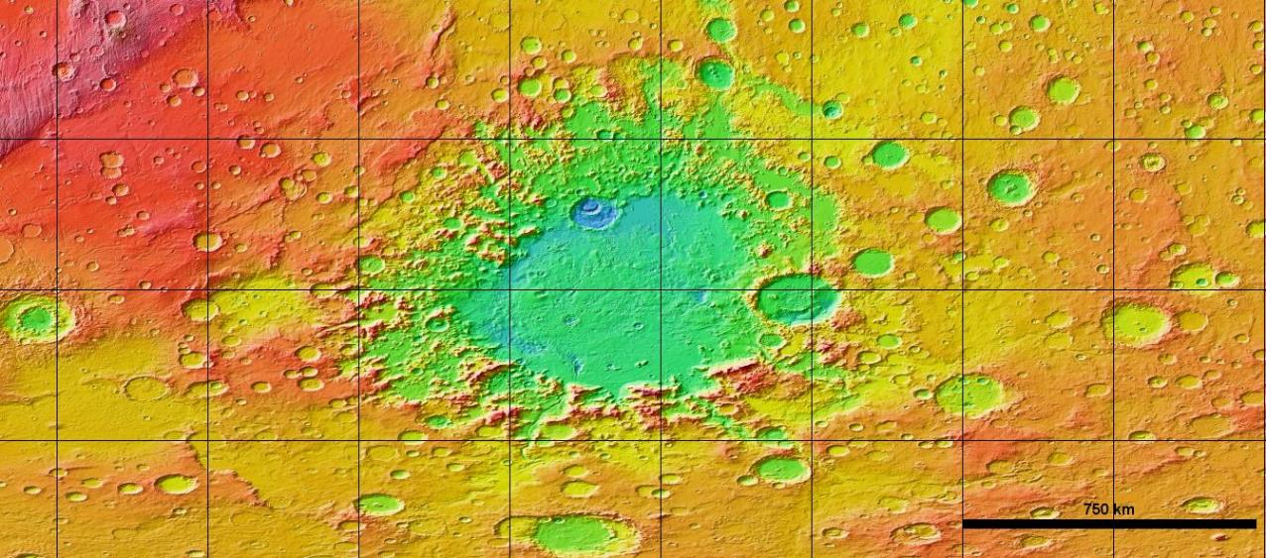
Region of Study
280 E
300 E
320 E
340 E
40 S
50 S
60 S
Mars Orbital Laser Altimeter (MOLA) Composite
Notes:
This is the Argyre impact basin. Note the severe degradation of the crater wall. The Southern mountains (the Charitum Mountains) within the blue box is the focus of my study. I will be sharing images and data from 3 regions within the mountain range; these are highlighted by the black boxes. These regions were chosen as examples of the features that can be seen throughout the landscape.

Slide 7
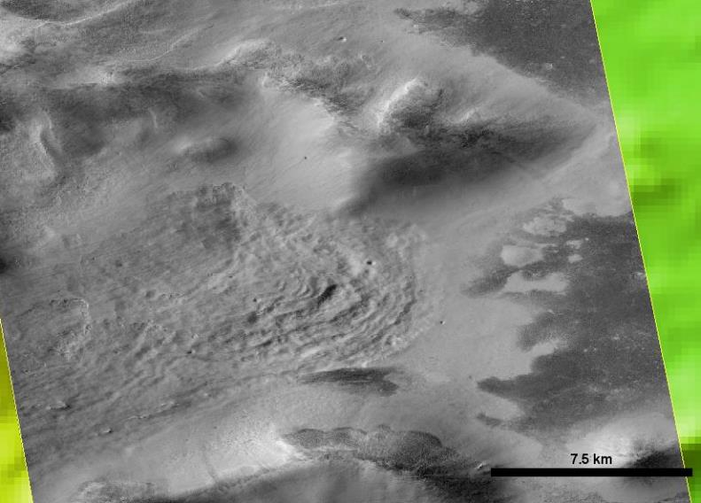
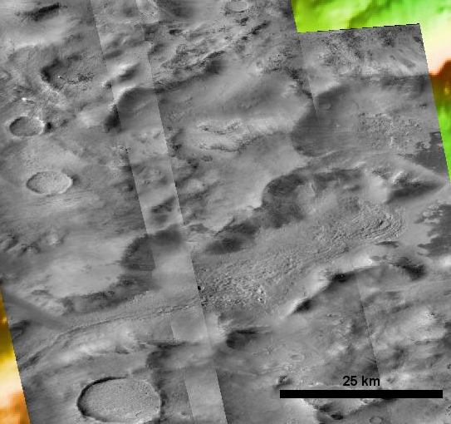
Imagery
CTX Images: Left: Composite of B12_014154_1247_XI_55S059W, G16_024492_1237_XN_56S058W, G12_022725_1237_XN_56S058W, B11_014088_1230_XN_57S057W.
Right: B11_014088_1230_XN_57S057W
Notes:
Southwest Argyre moraine candidate. The gradient of the valley is from high on the left to low on the right. This formation extends up the valley to the West. Possible valley formation was tectonic relating to the initial impact (cite: Kargel), and further deepening/modification from glacial action. Note the flow-like lobes of the furthest down valley part of the feature. Terminal moraines, recording a recession event? Stagnation deposition? Sunlight direction from the North.

Slide 8
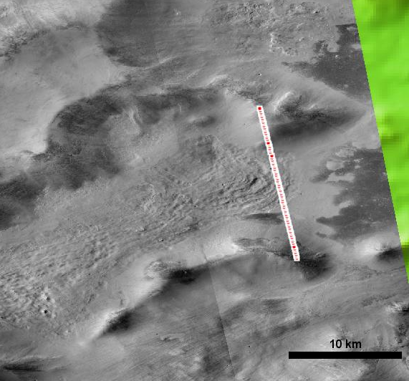
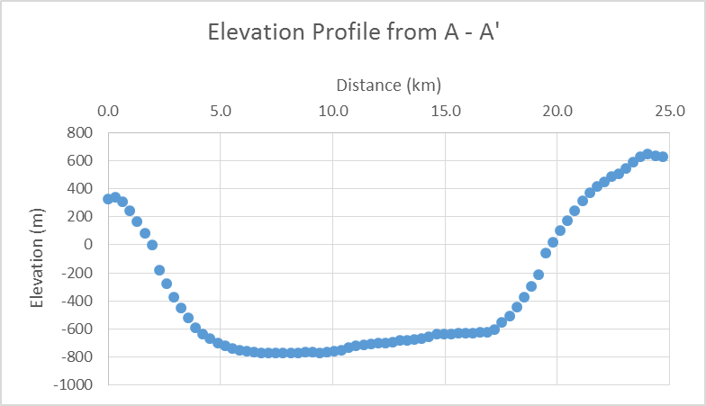
A’
A
A
A’
Elevation Data from Mars Orbiter Laser Altimeter (MOLA) Precision Experiment Data Records (PEDR), Orbit 11894 with overlaid CTX images G12_022725_1237_XN_56S058W and B11_014088_1230_XN_57S057W
Notes:
Cross section of the mouth of the valley from the previous image. Note the U-shape of the valley – a hallmark of wet-based terrestrial glaciation. Elevation points or from MOLA PEDR orbit 11894. Sunlight direction from the North.

Slide 9
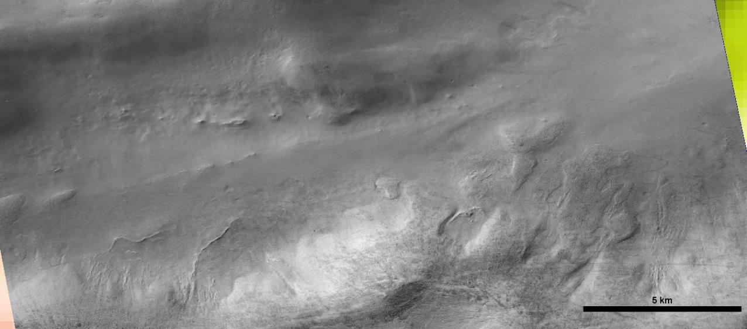
Sunlight direction
Streamlined formations
Medial Moraine Candidate
Streamlined Formations
CTX Image:
Esker Candidates
Notes:
Western Argyre, near the area highlighted by Banks et al. 2009. Esker candidates, streamlined formations, medial formations – streamlined formation or medial moraine. Gradient is from high on the left (W) to low on the right. Note the sinuosity of the esker-like features, their orientation down valley, their raised relief over the surrounding landscape, and their terrestrial-like scale. Streamlined formations have been sculpted by some force, parallel to the local topography; ice is a likely candidate. Sunlight direction from the North.

Slide 10
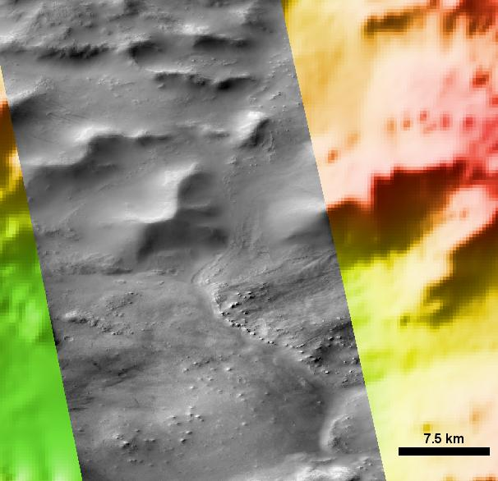
MOLA Elevation Data with overlaid CTX image P14_006479_1246_XN_55S029W
Notes:
Eastern Charitum Montes. Possible confluence of two glaciers in the center of the image. Terminal moraine candidate from the East Is clearly evident; flow feature from the North is visible; line of contact is visible. Using MOLA PEDR data to characterize the terminal moraine candidate…

Slide 11
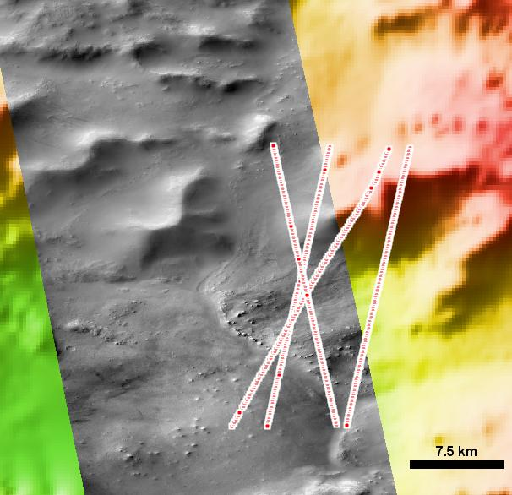
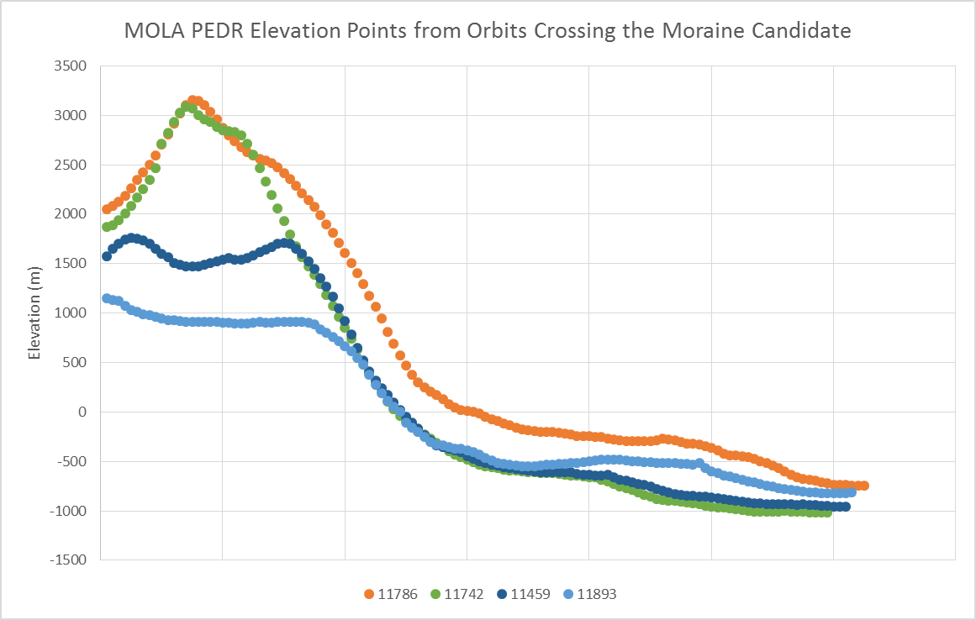
MOLA Elevation Data with overlaid CTX image P14_006479_1246_XN_55S029W MOLA PEDR Orbits 11786, 11742, 11459, 11893 Accessed through the PDS Geosciences Node Mars Orbital Data Explorer, Washington University, St. Louis http://ode.rsl.wustl.edu/mars/indextools.aspx
A
A
11459
11742
11893
11786
A’
A’
Notes:
…we can see that there is a positive relief feature that corresponds to the feature documented in the CTX image. Indeed, mapping the boundary between each orbit and the edge of the terminus, one can see that the feature is convex. This is a feature that is geomorphically consistent with an actual glacier. Sunlight direction from the North.

Slide 12
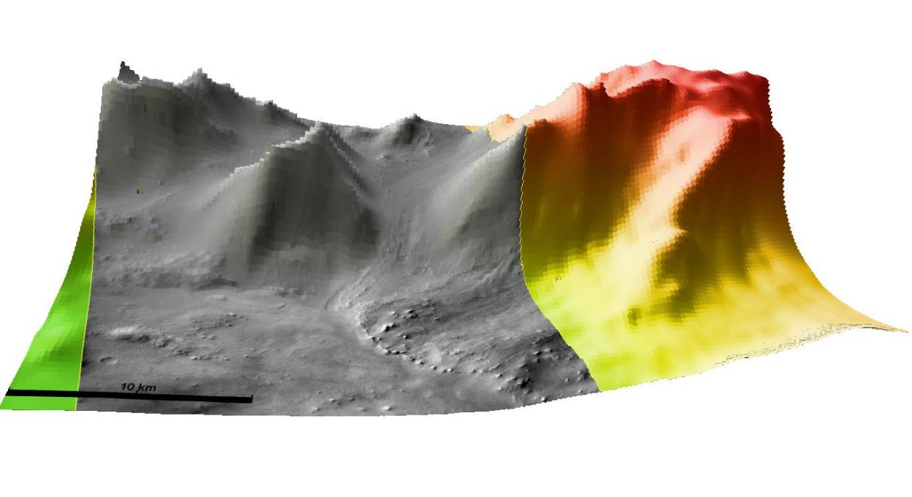
50X vertically exaggerated MOLA Elevation Data with overlaid CTX image P14_006479_1246_XN_55S029W
Notes:
3D layer of the same region an images. The elevated nature of the terminus is clearly visible. Note that the hanging valleys to the North become very evident.

Slide 13
Conclusions and Future Work
New imagery reveals geomorphic evidence consistent with the ancient glacial modification hypothesis
Wet-based glaciation?
If so, could be indicative of paleoclimatic conditions conducive to the existence of water on the Martian surface
As additional HiRISE imagery becomes available, there are many more areas of interest to study at higher resolution

Slide 14
Thank you!
Special thanks to my mentor, Victor R. Baker, for accepting me as an intern and introducing me to this field; to Jeffrey S. Kargel, for teaching basic glacial physics, and for assistance in image interpretation; to Susan S. Brew and the entire UA/NASA Space Grant team – being accepted as an intern has been a true honor!

